Slide 1
IMMIGRATION UPDATES
immigration@waccofseattle.org
206-636-9882
www.waccofseattle.org
Steven Denton

Slide 2
West African Community Council
Our Philosophy
To advocate, organize, assist, educate, and support West African community members while preserving our tradition, culture, social, religious, and moral beliefs.
Programs and Services
Immigration
Labor Rights Education
Early Learning and Parent Child Plus Program
Locations
Seattle Office Kent Office
6322 44th Avenue S 19435 68th Avenue S, Suite S-105
Seattle, WA 98118 Kent, WA 98032

Slide 3
Today’s Agenda
Immigration Updates
Know Your Rights and Family Preparedness Plan
New Immigration Options
Community Questions

Slide 4
Immigration Updates

Slide 5
CHANGES IN IMMIGRATION ENFORCEMENT
Deportation Ban
Biden Administration attempted to ban most deportation for 100 days after taking office
This ban was prohibited from taking effect by a Texas court
Deportations have continued
Enforcement Priorities
National Security (Terrorism, Espionage)
Border Security (Arrivals on or after 11/01/2020)
Public Safety (gang membership, serious convictions, etc.)
Ending Courthouse Arrests
Revoked prior ICE memo authorizing such arrests and limits future ICE arrests at courthouses to limited circumstances
Biden Admin Increasing ICE Funding
Biden 2022 budget proposal funds ICE at higher amount than Trump admin average
Notes:
● Deportation Ban
https://www.npr.org/2021/02/24/970914755/judge-bans-enforcement-of-bidens-100-day-deportation-pause
● Enforcement Priorities
January 20, 2021, David Pekoske Memo:
https://www.dhs.gov/sites/default/files/publications/21_0120_enforcement-memo
_signed.pdf
o February 18, 2021, Tae Johnson Memo:
https://www.ice.gov/doclib/news/releases/2021/021821_civil-immigration-enforc
ement_interim-guidance.pdf
● Courthouse Arrests:
https://www.cbp.gov/sites/default/files/assets/documents/2021-Apr/Enforcement-Actions
-in-Courthouses-04-26-21.pdf
● ICE Funding
https://www.npr.org/2021/05/28/1001377999/biden-hasnt-changed-ices-budget-but-he-has-changed-the-agencys-approach

Slide 6
ALLOWING MORE ENTRY TO US
Ending the Travel Ban
Ended travel ban from several Muslim-majority countries on Jan 20
Change in “Migrant Protection Protocol”
Persons no longer being denied entry to US under MPP
Beginning to allow phased entry into the US for those held in Mexico under MPP
BUT – Still enforcing restrictions on entry at southern border due to COVID
Easing Some Restrictions of COVID Presidential Proclamation
Allows entry to the US for all persons seeking immigrant visas
Greater Refugee Resettlement
Allowing for resettling of 62,500 refugees in US, far lower than campaign promise of 125,000
Notes:
https://www.whitehouse.gov/briefing-room/presidential-actions/2021/01/20/proclamation-ending-discriminatory-bans-on-entry-to-the-united-states/
https://www.dhs.gov/migrant-protection-protocols
https://travel.state.gov/content/travel/en/News/visas-news/presidential-proclamation-on-the-suspension-of-entry-as-nonimmigrants-of-certain-additional-persons-who-pose-a-risk-of-transmitting-coronavirus-disease-2019.html
Title 42 of US Code Section 265 (a public health law) continues to be used to restrict entry at southern border (returned to Mexico or held in CBP facilities and returned to countries on flights with no opportunity to seek asylum—Biden administration amended this policy to exempt unaccompanied minors). Since 02/2021 CBP has carried out more than 520,000 expulsions. Many of these numbers could reflect repeated attempts at entry, however.

Slide 7
CHANGES TO LAWS AND REGULATIONS
Ending the New “Public Charge” Rule
2019 “Public Charge” rule no longer in effect, reverts to 1999 rules
Receipt of SNAP, Medicaid, and other public benefits no longer detrimental to immigration applications
Form I-944, Declaration of Self-Sufficiency eliminated
Slow to Undo Other Rule Changes and Court Decisions
A patchwork of final rule changes to US Code of Federal Regulations remain in effect, though some are limited by court orders
Many immigration and appellate judges appointed by Trump remain in positions
A long list of damaging immigration judicial opinions remain in effect limiting relief in immigration court
Notes:
https://www.uscis.gov/green-card/green-card-processes-and-procedures/public-charge

Slide 8
NEW COURT DECISIONS
Holding ICE to NTA Requirements
Niz-Chavez v. Garland
Specific to Cancellation of Removal “Stop-Time” Rules
May allow more people to receive green card through “Cancellation of Removal” in immigration court
May open the door to other immigration court strategies and arguments
No “Admission” in TPS
Sanchez v. Mayorkas
Finds that Temporary Protected Status does not give someone an “admission” to the United States that could more easily allow certain persons to apply for a green card

Slide 9
OTHER UPDATES
REAL ID Requirements Delayed
New ID requirements for domestic air travel delayed until May 2023

Slide 10
Know Your Rights

Slide 11
If Immigration or Police Stop You On the Street
Do not run, Ask if you are free to go
Remain Silent
Do not say where you were born
Do not tell them how you entered the US
Do not show any documents
If immigration asks to see your immigration documents, and you have an immigration status, you must show them (do not lie or provide false documents)
Police can require you to show an ID if you are driving a car or in situations involving alcohol
Do not consent to a search
ICE cannot search you without probable cause
Police may pat you down if they suspect a weapon
If detained, remain silent, do not sign anything, ask to speak to a lawyer
Notes:
ICE must have reasonable suspicion which requires specific articulable facts which warrant the intrusion in order to hold for questioning. Race/ethnicity and language are not facts that can give reasonable suspicion of noncitizenship.
You DO have the right to remain silent. “Am I being arrested or detained?” If the officer says no, then ask “Am I free to leave?” If they say yes, calmly walk away. If they arrest you, ask to call your lawyer.
Do not show any documents, except a letter from a lawyer or your US identification, like a driver’s license or a state id card. Above all, do not show any false documents!
Do not sign anything, especially an Order of Voluntary Departure, without first talking to a lawyer.
Don’t carry false documents or foreign identification.

Slide 12
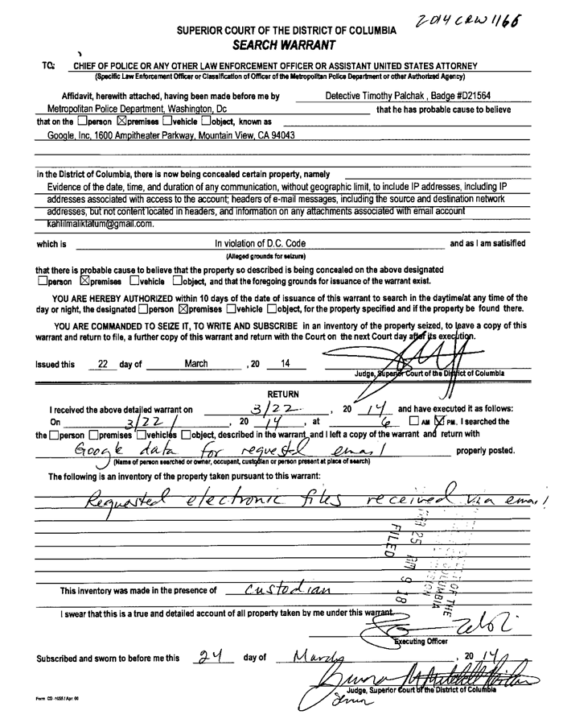
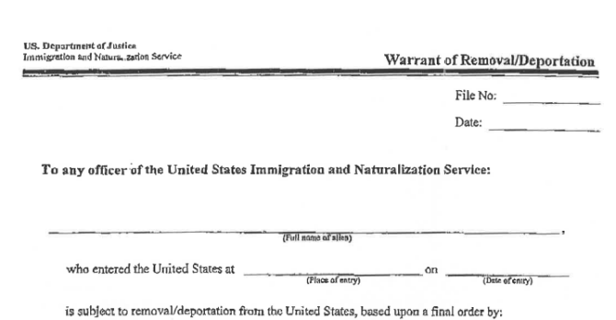
If Immigration/Police Come to Your Home
Do not open the door, ask for identification and a warrant
Notes:
Ask to see a Search Warrant. If the official does not show you one, you do not have to open the door.
Do not sign anything, especially an Order of Voluntary Departure, without first talking to a lawyer.
“I do not consent to you being in my home. Please leave” or “I don’t want to talk to you right now.”
If you allow them in, you lose some of your rights.

Slide 13
If Immigration/Police Come to Your Home
If you must allow immigration in your home:
Say that you do not consent to a search
You or a family member may record the interaction
Remain silent
If detained, remain silent, do not sign anything, ask to speak to a lawyer
Report the activity
National Immigration Project
1-(844) 363-1423
Notes:
Ask to see a Search Warrant. If the official does not show you one, you do not have to open the door.
Do not sign anything, especially an Order of Voluntary Departure, without first talking to a lawyer.
“I do not consent to you being in my home. Please leave” or “I don’t want to talk to you right now.”
If you allow them in, you lose some of your rights.

Slide 14
If Immigration/Police Come to Your Work
ICE/Police need warrants to enter private spaces
Do not run
You may leave the area calmly
If you are questioned:
Ask if you are free to leave
Remain Silent
Do not show documents
Do not consent to a search
If you are detained:
Remain Silent, Do not sign anything, Ask for a Lawyer
Notes:
Do not run. It is better to remain calm.
You can calmly leave an area where the Immigration Service has come.
employers don’t have to let anybody enter their building without a search or arrest warrant. This may be a good topic to address ahead of time with your employer so that they understand their own rights and can better protect their employees.
Do not sign anything, especially an Order of Voluntary Departure, before talking with a lawyer.

Slide 15
Creating a Family Preparedness Plan

Slide 16
How to Be Prepared
Identify a Legal Aid Association
Office of Immigrant and Refugee Affairs: 202-727-8515
ELDN (Expanded Seattle-King County Immigrant Legal Defense Network) https://www.seattle.gov/iandraffairs/programs-and-services/legal-defense-fund-and-network
King County Public Defense: 206-296-7662
Make a Child Care Plan
Find a trusted adult who can care for your child if you cannot.
Consider filling out a “Temporary Parental Consent” form.
Does not need to be notarized, unless you want child to travel across international borders. https://www.washingtonlawhelp.org/files/C9D2EA3F-0350-D9AF-ACAE-BF37E9BC9FFA/attachments/85DDF5D1-548E-4045-BB8D-54B0C818A771/8166en_temporary-custody-agreement_immigrants.pdf
Have a list of emergency numbers and contact information
Discuss this plan with your child

Slide 17
How to Be Prepared (Continued)
Inform Family and emergency Contacts About How to Find You if You Are Detained by ICE
Family members can use the ICE detainee locator: https://locator.ice.gov/odls/homePage.do
Make sure your family and emergency contacts have a copy of you’re A-number, if you have one.
Gather Documents in a Secure Place
Documents for yourself and children including passports, receipt notices, approval notices, etc.
Give someone you trust access to these documents

Slide 18
How to Be Prepared (Continued)
Know Your Rights
Save for Legal Fees/Bond
Bond or release from detention can cost several thousand dollars
Speak with an Attorney/ Know Your Legal Options
Avoid All Contact with Law Enforcement/Arrests/Criminal Charges

Slide 19
New Immigration Options

Slide 20
DACA
First time and renewal applications being accepted
Persons who were under 31 as of June 2012 and arrived to US before 16th birthday may be eligible
International travel under Advance Parole possible again
TPS
New designation of Temporary Protected Status for nationals of Haiti/Burma (Myanmar)
Liberian Refugee Immigration Fairness Act
Permanent residency made available to some Liberian nationals present in the US since Nov 20, 2014
Deadline for applications extended until Dec 20, 2021

Slide 21
Proposed Immigration Laws
US Citizenship Act of 2021 (Biden Proposal)
Allows undocumented individuals to apply for temporary status with a pathway to permanent residency after five years
Limitations on eligibility for those with criminal issues
Eliminates one-year filing deadline for asylum and makes available more humanitarian visas (U and T)
House of Representatives Bills
Passed two bills in March allowing for legal status for those brought to the US as children and for agricultural workers
Narrower than Biden proposal

Slide 22
CALL YOUR REPRESENTATIVES It takes action!
https://www.house.gov/representatives/find-your-representative
https://www.senate.gov/senators/senators-contact.htm
Support Immigrant Advocacy Organizations

Slide 23
Questions?
General questions only please. We are happy to talk to you about your individualized concerns but would like to do so privately.
To schedule an intake or appointment with WACC:
Call: (206) 636-9882
Email: immigration@waccofseattle.org

