Slide 1
Vacate a Conviction to Change a Life
A CLE from Civil Survival’s Reentry Legal Aid Project

Slide 2
My Goals Today
Vocabulary: People with convictions, “Collateral Consequences” and why I hate that phrase, what is “Vacating” a record.
Who you’ll help
How a conviction becomes a barrier
Explain what RLAP is
The process for vacating convictions
LFOs!
More LFOs!
Q & A

Slide 3
People with Convictions
Notes:
Talk about Vocab:
“People with Convictions” – not felons, not convicts, not offender, not defendant. These are ugly labels, and they are often inaccurate. These are people with convictions, they’re your clients, they’re other people who have been impacted by the justice system.

Slide 4
“Collateral Consequences”
Notes:
Who here has heard the term “collateral consequences?”
Collateral consequences is a term to describe the enormous impact of a conviction on someone’s life that stretches beyond what they are literally sentenced to. For example, someone might be convicted of theft 3, a shoplifting charge, and be sentenced to 200 hours of community service. But as a “collateral consequence” there may be $600 in court fees and fines to pay. The debt from those fines may impact that persons credit score. Their insurance rates go up, they cant be approved for a credit card, and the can’t pass a background check to get a new job. “Collateral consequences”. You will hear that phrase a lot in criminal justice language to talk about all the mess of things that come down on a person as a result of a conviction.
If you take one thing away from this presentation, it’ll be to stop using this term.
And here’s why: as attorneys and legal professionals we use the term collateral consequences to describe the incidental impact of a conviction on someone’s life. But this is actually a euphemism. I’ve just listed a fraction of what happens to someone who gets even a minor misdemeanor conviction on their record. And I want you take a minute and reflect on two things with me:
I’ve just listed a bunch of consequences to a conviction, which is another way to say that none of these are a surprise to anyone. The fact that owing a pile of money in court fees leads to damage to your credit score or that it makes it much harder to get a new job should not be new information for anyone here, and certainly not for a prosecuting attorney, or a Judge. These aren’t actually incidental consequences.
And two, these are only “collateral” to us, to the legal professionals. To the people with the convictions, these are just CONSEQUENCES, no more of less consquences than the community service. It’s all the same to the person who actually suffers under them.

Slide 5
Vacating v. Expungement v. Sealing
Vacating
Only removes record of conviction from Washington State Patrol report (WATCH). Does not affect court record.
Expungement
Only affects Washington State Patrol; removes records of nonconviction data (e.g. arrests or deferrals). Does not affect court records.
Sealing
Makes court documents inaccessible to public.
Notes:
And here’s the final vocabulary word for you to leave today with. Vacate.
You should VACATE people’s convictions. If you look this up on Google you will see a mix of terms used by attorneys about “deleting” and “expungement” or “sealing” of people’s convictions.
But what you need to know is that in Washington state, if someone has a conviction, it needs to be “Vacated” to be removed from their background checks. Once an order vacating a conviction is entered by a Judge, because of all the hard work you’ve done as a volunteer for your client, then the Washington State Patrol’s public statewide database of criminal records is updated to remove that conviction from being shared publicly and it slowly disappears from the employer background check companies.
Expungement is a process of requesting the WSP to remove arrest records that did not lead to a conviction, which the WSP removes themselves after a period of years. In other words, expungement is for fixing mistaken WSP records, not for removing conviction records.
And “sealing” is to make the actual court records themselves inaccessible to the public and in King County is extremely rare, because the Court is ordered to weigh the public interest in the court record against the individual’s need for sealing, and they’ve set that bar very high. People fleeing from an abuser might have grounds to seal their record, but our clients wont’.

Slide 6
Who You’ll Help
Notes:
So now that we can all talk using the same language, let’s talk about some of the folks we’ve served so you can see why the work is important and why you should get involved.

Slide 7
Client Hypothetical Judy
1978
Possession of Stolen Property – Felony
Employed through DSHS
Temporary unemployment due to injury
Currently unable to find employment
Notes:
Judy is a typical client – someone over the age of 50 who has had to find work after a period of unemployment, and suddenly their old conviction has reared its ugly head and they’re not able to find work.
In 1978, Judy was 18 years old. Her home life was unstable – her parents were going through a divorce and she was shuffling back and forth between the two households. Judy’s mom was an alcoholic and Judy had very little support.
Judy has a 41-year old charge for Possession of Stolen Property. She was the passenger of a stolen vehicle. She didn’t serve any jail time, but she was on probation for 3 years.
Judy also has one misdemeanor conviction. We wish we knew what it was, but it is unavailable through the court record because it’s just that old. She has had no convictions in over 30 years. She is a licensed missionary evangelist and her faith has carried her through the hard times. She was briefly employed through DSHS, and then went on to work as a caregiver until she was injured on the job in 2018. Her conviction record had never previously been an issue.
Judy recovered from her injury, but suddenly she can’t find a job because those old convictions were popping up on her background check, and employers were turning her down. Judy has been rejected from several employers specifically on the basis of her criminal history.
Judy had her record successfully vacated and is now employed.

Slide 8
Client Hypothetical Amanda
Single mom
3 Children – 10, 5, and 3
5-year-old is relative’s child, Amanda is adopting
No Valid OP x 20
1994 – Theft-3rd
2004 – Marihuana Possession Less/Equal 40g
Currently unable to find employment or housing
Notes:
Amanda is another example.
Amanda is a single mom with 3 children: 10, 5, and 3 years old respectively. The 5-year-old is a relative’s child, and Amanda is seeking to adopt them.
If you were to look up Amanda’s criminal record and you weren’t familiar with the policing tactics of King County law enforcement, you might be shocked. Amanda has nearly 25 convictions. You might be picturing a career criminal, someone in and out of prison for a series of crimes. But that’s not the real story.
In the 90s and early 2000s, law enforcement specifically targeted and pulled over people who had a previous conviction for driving with a suspended license.
How it works is this way: Imagine you are someone with who gets a few traffic tickets, but youdon’t have the money to pay them. Or, maybe, you fall behind on your car insurance payments and get in a fender bender, and you arecharged with driving without insurance (a traffic infraction, not a conviction). As a result, the your license is suspended until you can pay the fines, which now include the traffic tickets, and court fines, and the car insurance. But you didn’t have the money for the tickets in the first place, so you are never going to have the money to pay everything now. Unfortunately, because you don’t have a lot of money you can’t afford to live in Seattle, you live in Renton and drive to work downtown every day.
What happens next is that on your way to work a cop runs your plates, and discovers that you are driving with a suspended license. You get pulled over and get charged with Driving with License Suspended in the 3rd degree, or “No valid operators license”, a criminal charge (not a traffic infraction.) Just add one more set of fines to your pile. And then a week later, again on your way to work you get another one. And then another one.
This was an extremely common policing tactic until not that long ago, and that is why you end up with folks like Amanda who ended up with TWENTY convictions for “no valid operators license”.
Beyond that, Amanda only has two convictions:
In 1994, Amanda was charged and convicted of Theft in the 3rd degree, a gross misdemeanor. At the time, she was 19 and was caught shoplifting.
In 2004, Amanda was charged and convicted of marijuana possession in the amount equal to or less than 40g. This is a class C felony, but still vacatable. She had a one-year probation period and then a 5 year waiting period. She alleges that she only had a joint in her pocket.
So what happened to Amanda since then?
In the last five years, Amanda has not had a criminal record of any kind. She is doing her best to be a role model for her children, but she is currently unable to find employment or housing. In the state of Washington, only Seattle has any kind of statute that prohibits landlords or apartment management companies from rejecting applicants for housing on the basis of a criminal record. However, even if she wanted to live in Seattle, she is completely priced out of the market because it is too expensive for her income as a single mom taking care of a household of 4. If she applies for any kind of state or federal housing subsidy, she will likely have her criminal record evaluated and similarly be discriminated against on the basis of background history.
Because Amanda cannot find housing, she also has difficulty finding employment. Employers often use addresses to screen clients, who believe that where you live can often say a lot about who you are. If Amanda lists a shelter’s address, employers will flag that as someone who is higher-risk to hire or believe that this means someone is less reliable, even though this is fundamentally and proven to be untrue. Amanda does not have any immediate family to rely on.
Amanda is busy: she has three young children to take care of, and she has to resolve her employment and housing issues. Many of our clients are often dealing with traumas without the benefit of strong support systems, like a school counselor, close friends and family, or a therapist.
Amanda has neither the time nor the expertise to go through the process of vacating these convictions. That’s where you’ll come in.

Slide 9
How a Conviction Becomes a Barrier
Notes:
Now let’s look at what a conviction like the ones Amanda or Judy had and how that get turned into a barrier.

Slide 10
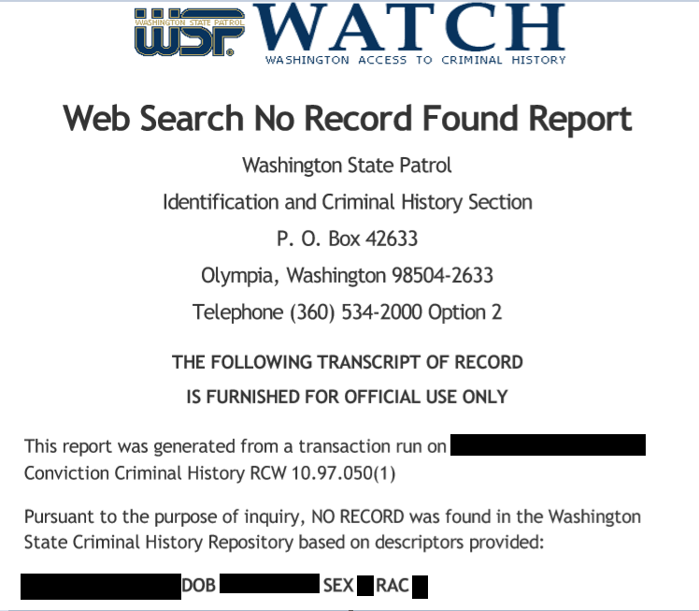
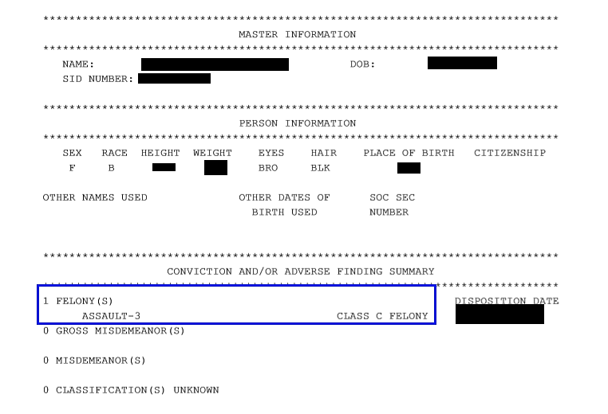
WSP – WATCH REPORT
Notes:
Here is an example of a WATCH report, the Washington State Patrols PUBLIC record system. This is the actual system that most background check companies pull from in order to report to potential employers. They sometimes refer to it as a RAP sheet.
You can see on that second page how they list “Conviction and/or Adverse Finding Summary”

Slide 11
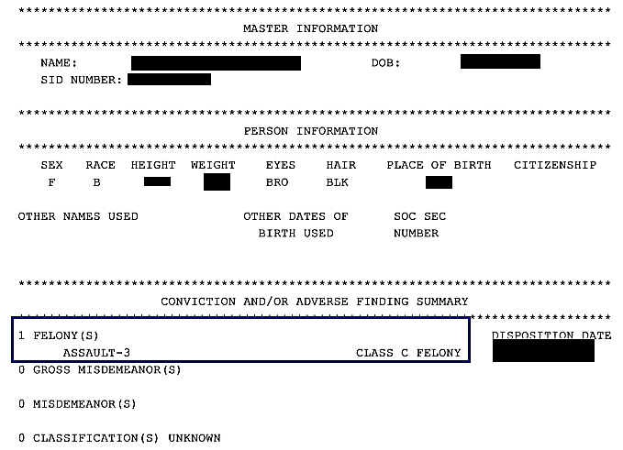
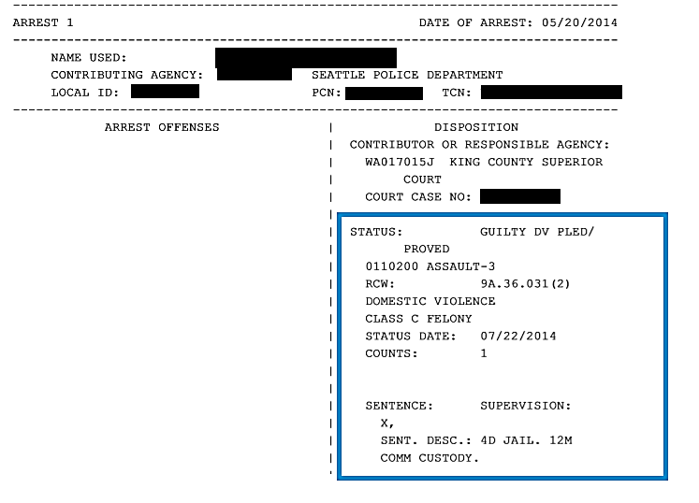
WSP – WATCH REPORT
Notes:
And here is the next page, which shows how sparse the details are on what is reported. That second picture shows the details: the charge, the date, and the sentence.
When you vacate a client’s conviction this information all gets deleted from public consumption, so after a volunteer vacated these two municipal code violations for this client their WATCH report would be blank.

Slide 12
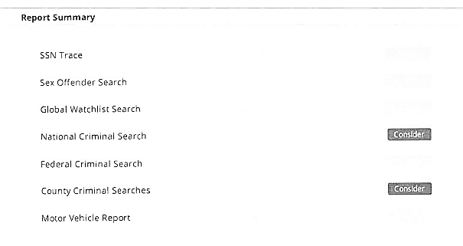
Background Checks
Notes:
And finally, here is what one of our former clients background check actually looked like from an employer that denied them employment. A big warning that says “Consider” next to national criminal search and county criminal searches. There was a second page (that included too much personal info) that listed what convictions were found.
That’s how a conviction on someone’s record becomes a denied job application or a denial for housing. Vacating solves this problem. That’s where you come in.

Slide 13
What’s RLAP?
Notes:
We’ve covered how someone get’s a conviction on their record, and how that conviction becomes a denial for employment or housing. We’ve also mentioned how vacating a conviction removes it from a background check so it will no longer pose a barrier. Where do you come in?
The Records Project trains and mentors volunteer attorneys on how to vacate convictions, interviews and vets clients for eligibility to vacate a conviction, and then we pair those eligible clients with volunteer attorneys to do the paperwork.

Slide 14
What do we do?
We mentor and recruit volunteer attorneys and pair them with clients to “vacate” (remove) eligible conviction records.
Research Cases, Train volunteers, work with clients and attorneys and the Courts.
Make sure the process is as easy and fast for attorneys as possible.
Notes:
What do we do?
We make sure this process is as easy and simple as possible for you folks. By the time you take a case we’ve already determined that the client has a likely eligible conviction to be vacated, and we’ve pulled together the case documents for you. We’re here to answer to questions, to provide logistical support, and basically do whatever we need to so that you can focus on helping the client. We want this to be as easy and fast as possible so we do all the behinds the scenes work and you get all the glory.

Slide 15
The Process
Notes:
What does the work actually look like? I estimate a typical case takes 10-15 hour for your first one. The majority of your time working a case will be following up with the prosecuting attorney and court personnel to make sure they look at your paperwork.
Now we’re going to show you what that process looks like.

Slide 16
What Makes a Conviction Eligible?
Only certain types of convictions
Most/All Obligations complete
A number of years since completion
No recent convictions or pending charges
No active restraining orders or open warrants
Notes:
We have mentioned a few times that folks in Washington state can only vacate “eligible” convictions and you’re probably wondering what makes a conviction eligible. Now we’ll already have done a lot of the legal research of this before you get a client so hopefully this won’t be as important for you as it is for us when we’re vetting the clients, but it is going to be helpful to get a quick overview of the laws generally so you’ll know what we’re looking for and when you see the court forms it’ll make sense.
A quick warning: the vacating statutes are short but in practice they get very messy so we’re going to cover these rules generally. It’ll make a whole lot more sense what this all means when you have an actual case in front of you so you can focus on how these laws fit in with an actual person’s record. Like everything involving the justice system there are an endless number of exceptions or loopholes that make this messy, which is part of why people need lawyers! All of this comes from RCW 9.94A.640 (for felonies) and RCW 9.96.060 (for misdemeanors).
So here are the general rules for what makes a conviction eligible to vacate:
1) Only certain types of convictions are eligible to vacate. Sex offenses and DUIs are not eligible to vacate, full stop. Violent offenses can be eligible if they were minor. If someone has a single domestic violence conviction on their record it can be eligible to be vacated, but if they have more than one they’re not eligible. This is a big part of why motions to vacate are generally very easy work: most of the complicated convictions are not going to be eligible to be vacated anyways, so almost all of our motions to vacate are agreed to by the prosecutors and signed by the Judge without any issue. The difficult convictions just aren’t eligible.
2) Here’s one of those tricky pieces of the law that frankly doesn’t make a lot of sense. A misdemeanor conviction is only eligible if all of the sentencing obligations are complete. That means things like community service, probation, and usually the big one, all fines need to have been paid off. A felony conviction is eligible if all of the sentencing obligations are complete EXCEPT they don’t need to have completed paying off their fines. Yes, misdemeanors are harder to vacate than felonies.
3) A number of years needs to have passed since all the necessary obligations were complete. The actual number of years depends on the seriousness of the offense but it’ll be somewhere between 3 years for most misdemeanors to up to 10 years for a class B felony.
4) The client cannot have any convictions within a number of years, counting backwards from today. This number is also based on the seriousness of the offense and tends to mirror the above rule. So for a class B felony they can’t have had a conviction in the past 10 years. They also can’t have any pending charges.
5) And the client can be restrained by any sort of protective order or have an open warrant.
When you see the court forms we use you’ll see all of this language is reflected there and it’ll make more sense.

Slide 17
The Timeline
Receive the Case
Draft Paperwork & Communicate with Prosecutor
WAIT 4-6 WEEKS
File with Court
Receive Order
Meet with Client
Notes:
By the time you get a case to work on, we’ve determined the client has an eligible conviction or convictions (don’t worry, we’ll get to what that means) and collected their case file. You’ll get a zip file that typically contains a copy of the client’s WATCH report, a letter we sent the client breaking down which of their convictions might be eligible, and all the court documents we’ve been able to collect.
Now that you’ve received that case file, here’s what a typical case timeline looks like and where you’re going to be spending those 10-15 hours for your first case.

Slide 18
Meeting With Your Client
Limited Representation Agreement
Developing Rapport and Using Compassion
Adapt to Client’s Circumstances

Slide 19
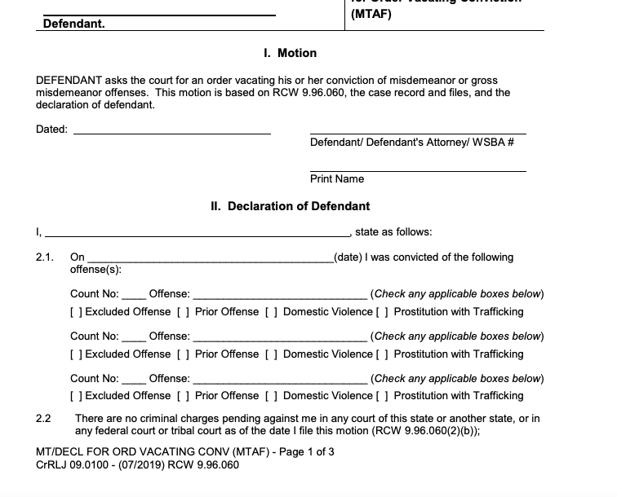
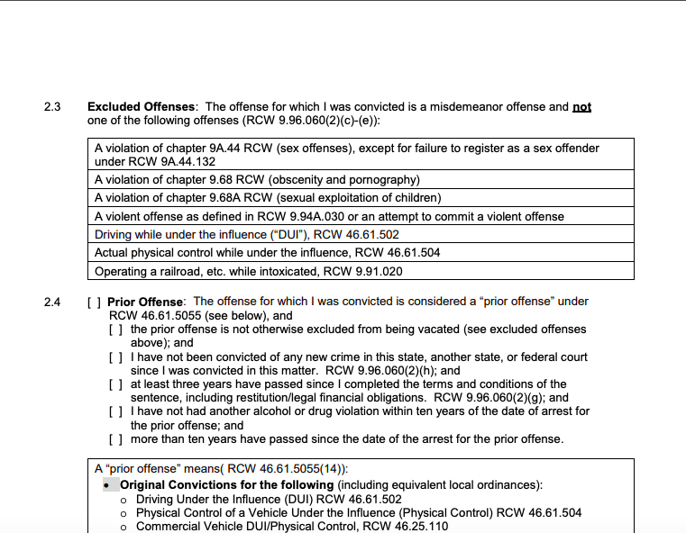
Example Misdemeanor Form
Notes:
You’ve talked with your client, you’ve found out why they came to the Records Project, and you’ve received from us a copy of the client’s background report and you see what we’ve listed as potentially eligible convictions to vacate. Now you’re ready to fill out the paperwork. Are you ready? Well I hope so because once you’ve gone through the process this might take you upwards of 30 minutes to fill out most of the forms.
Here’s a screenshot of page 1 and 2 of 3 on the motion to vacate a misdemeanor. You’ll notice most of it is a series of checkboxes.

Slide 20
The Paperwork - Misdemeanors
Notice of Appearance
Motion and Declaration to Vacate Misdemeanor Conviction
Order on Motion to Vacate Misdemeanor Conviction
Note for Motion (where applicable)
Notes:
Note: convictions related to marijuana or Indian Fishing Rights have slightly different paperwork. However, because we rarely see these convictions compared to others, we won’t be focusing on those documents today.

Slide 21
The Paperwork - Felonies
Notice of Appearance
Motion and Declaration to Vacate Felony Conviction
Order on Motion to Vacate Felony Conviction
Certificate of Discharge
Proof of Completion of Other Sentencing Requirements
Note for Motion (where applicable)

Slide 22
Filing & Serving
Procedures Vary by Court
KCSC – e-file & send filings to prosecutor’s office
SMC – E-file
No formal service necessary
Notes:
Procedures for filing and serving vary by court. For King County Superior Court, we have been asked to just send the filings to the prosecutor’s office in conjunction with e-filing. For Seattle Municipal Court, we have been asked to just e-file the documents. For other courts, like Kent Municipal or King County District Court, they may request to do it differently. If you have any questions or concerns about filing documents, we are happy to help you figure out the best way to do it.
Service is usually not an issue, particularly since we’re interacting with the Prosecutor’s Office directly.

Slide 23
After the Order
Notify Law Enforcement
Verify Court Records are Updated
Give your Client the Good News!
Start on the Next Conviction

Slide 24
Pro Tips
Ask to vacate multiple convictions in the same court at the same time
Certificate of Discharge, Waive LFOs and Vacate a conviction simultaneously
Deferred Convictions
Notes:
If your client has multiple, subsequent convictions from the same Court that may all be eligible to vacate, contact the prosecutor and ask whether they would be willing to vacate them all simultaneously. Generally, the Prosecutor’s Office seems to be more favorable to this in non-consequential misdemeanors (like Driving With a Suspended License or Theft-3). Some prosecutors are willing to accept the pleadings to vacate for multiple convictions all at once to be filed together. It saves the prosecutor time because they can review all the paperwork for your client all at once, and then multiple convictions can be vacated simultaneously.
A court may, at its discretion, refuse to delete non-conviction data for several reasons. This is especially the case if the record relates to deferred prosecution.

Slide 25
Let’s Talk LFOs

Slide 26
Definitions to Know
LFOs = Legal Financial Obligations
Mandatory LFOs = Restitution; Victim Penalty Assessment; DNA Collection Fee (one time)
Discretionary Costs = Court fees; PD fees; jury fees; etc.
Indigence = 125% of the Federal Poverty Level OR receives public benefits OR involuntarily committed OR served by a QLSP

Slide 27
What can we waive?
Superior Court
Interest on non-restitution LFOs
Interest on Restitution if the principal has been paid – RCW10.82.090
“Discretionary” and Appellate Costs
Prior to July 1, 2000: 10 years after release from total confinement or Sentence = if its not extended, EVERYTHING (State v. Gossage)
STATE V. BLAKE (to be continued…)
Court of Limited Jurisdiction
Everything EXCEPT very specific mandatory fees (like DNA collection fees)… these are rare
Everything else CAN be waived, but its discretionary
State v. Gossage also applies
STATE V. BLAKE

Slide 28
State v. Blake
Washington Supreme Court has determined simple possession convictions are unconstitutional:
The Courts must vacate possession convictions
The Courts must waive all LFOs related to those convictions
The Courts must REFUND any LFOs paid on those convictions
[Also they must resentence anyone impacted by these convictions]

Slide 29
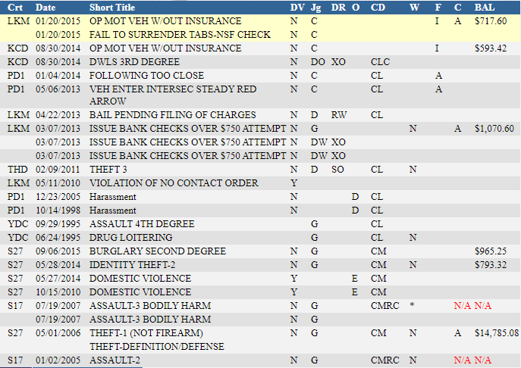
Hypothetical
6 cases with LFOs (at least)
Those top two are traffic infractions (noted by the C)
One in a CRLJ
Three in a superior court
Nothing from before July 1, 2000

Slide 30
Hypothetical Pt. 2 – Here’s what I see
Infractions cannot be waived by the same process (look into local city rules/process)
Lake Forest Muni case – potentially waivable in its entirety
S27 – Pierce County Superior Court = only non-restitution is waivable
BUT, not round numbers = interest or payments
S17 – King County Superior Court = need more info

Slide 31
What’s the process? (https://www.washingtonlawhelp.org/resource/filing-a-motion-to-remit-remove-financial-legal-obligations-in-district-or-municipal-court)
You’ll need to file something like the following:
Notice of Appearance
Motion to Waive or Reduce LFOs/Financial Declaration
- You can (and should) modify this
Proposed Order
Notice of Hearing/Note for Hearing/Note for Motion
Draft these Documents -> File them in the appropriate Court under the same case number as the original case -> Serve and talk with the prosecutor -> Talk to the clerk -> Set a Hearing;
Prepare to argue why your client should not be required to pay.

Slide 32
Tips!
These are much more discretionary than vacates, try to talk to someone with experience in that particular Court if you can
If you are volunteering for a QLSP, your clients are legally indigent, and this can be a way to avoid a lengthy financial declaration
A lot of this will come down to how persuasive you can be about your client’s life in five minutes, prepare an elevator pitch.

Slide 33
We Need You!
Notes:
So we’ve covered how to talk about criminal convictions, how people end up needing our help, and what we do. Now we need to ask you for your help. There is nearly an endless number of clients who need this help, and almost no resources dedicated to this work. We could do all this work ourselves but we would never be able to make a meaningful impact on the number of people who have eligible records. That’s where you come in.
Take a case, do the work, and see how much of an impact it has on a client. You’ll get to see first hand how a few hours of your time can completely turn someone’s life around. And then you’ll come back and take another case.

Slide 34
Any questions?
Jacob Kuykendall Civil Survival
Staff Attorney
Jacob.Kuykendall@defender.org

